Slide 1
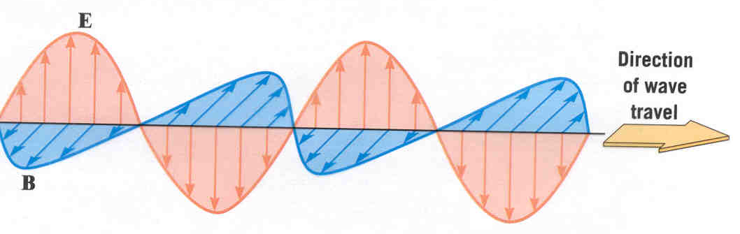
Electromagnetic Waves
The speed of electromagnetic wave is c
E and B are in phase
E⊥B, and E⊥k, B⊥k, k is the direction of the wave.
Polarization

Slide 2
Chapter 44 Polarization

Slide 3
Content of this Chapter
About polarization
Polarizing sheets
Polarization by reflection
Double refraction
Circular polarization
Polarization by scattering

Slide 4
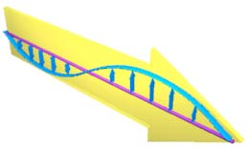
Linear Polarization
(plane polarized).
Polarization
Circular polarization
The plane determined by the E and the direction of propagation of the wave is called the plane of polarization of the wave.
E

Slide 5
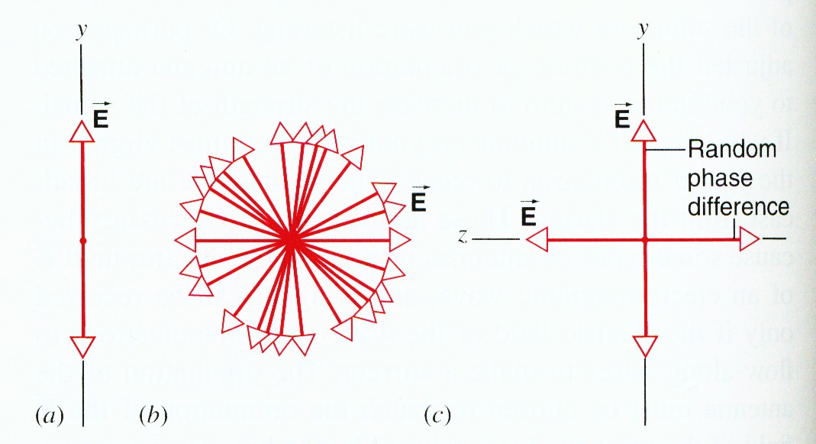
 Unpolarized

Slide 6
 Unpolarized
Unpolarized light is called nature light.

Slide 7
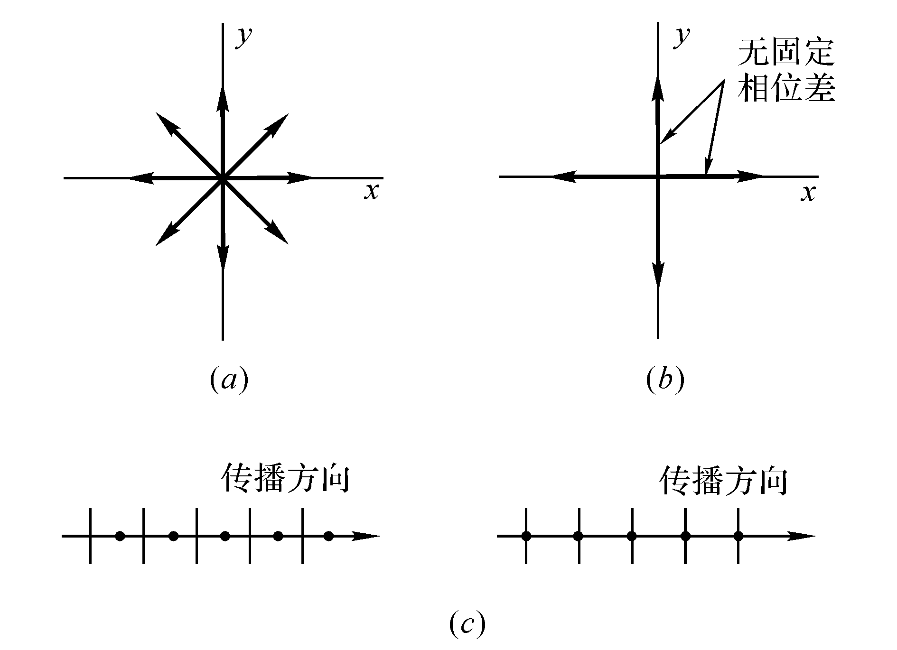
 Unpolarized
unpolarized
Partially polarized
Partially polarized
unpolarized
Unpolarized light is called nature light.

Slide 8
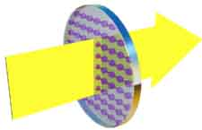
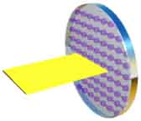
Polarizing sheets
 Polarizing sheet or polarizer
Polarizing sheet absorb all electric fields perpendicular to their polarizing direction.

Slide 9
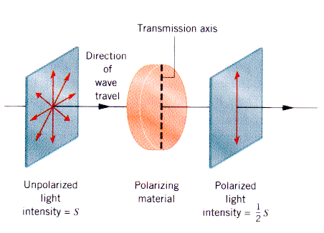
 Unpolarized light on polarizing sheet

Slide 10
 Linearly Polarized Light on Linear Polarizer (Law of Malus)
θ is the angle between the incoming light’s polarization, and the transmission axis.
TA
θ
E_{tranmitted} = E_{incident} cosθ
E_{tranmitted} = E_{incident} cosθ
I_{transmitted} = I_{incident} cos²θ
Law of Malus

Slide 11
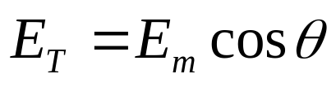
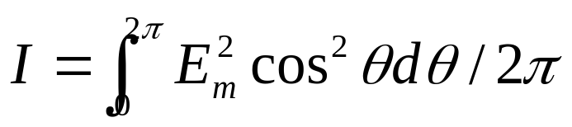
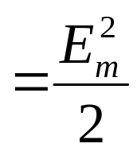
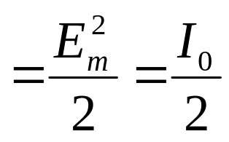
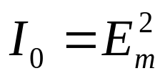
I=?

Slide 12
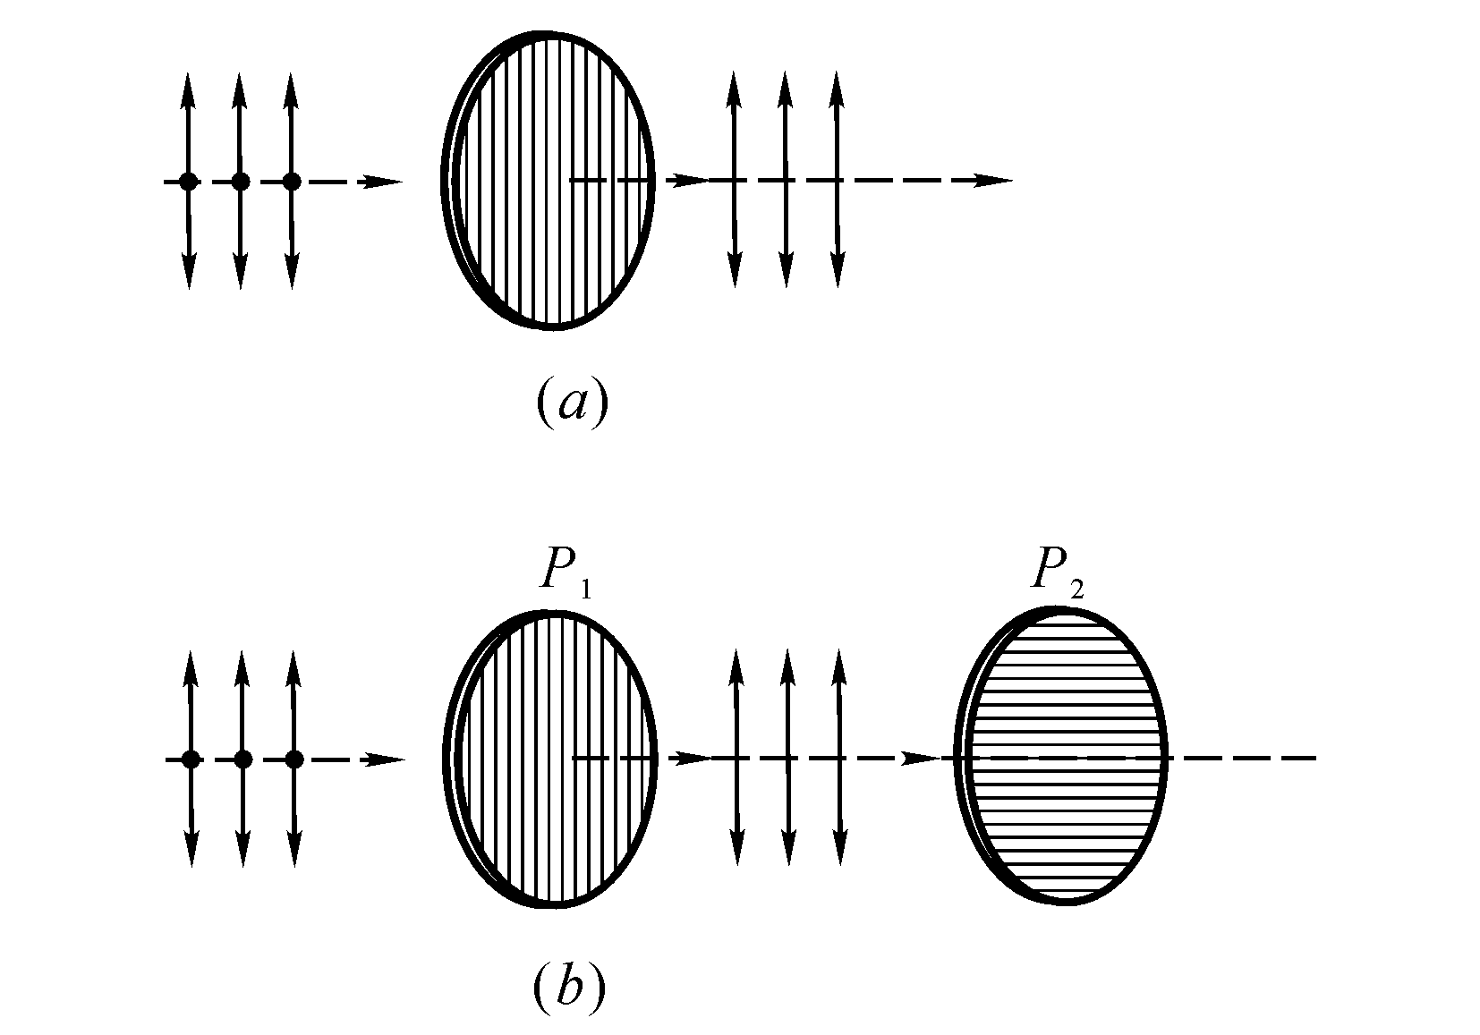
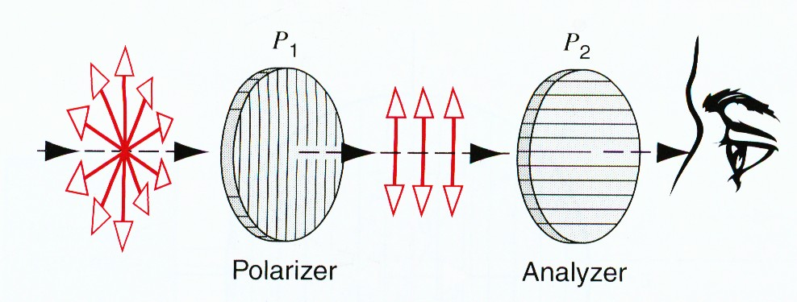
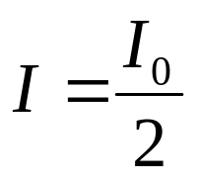

Slide 13


Slide 14

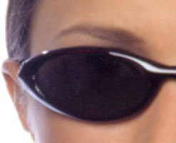
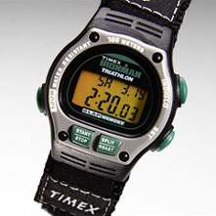

Slide 15




Example
un-polarized light
polarized light
partially polarized light

Slide 16



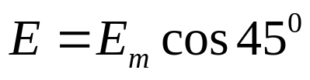
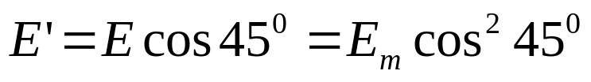
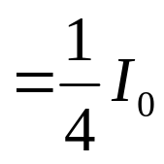
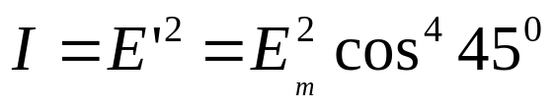
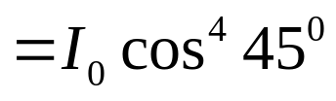
Example

Slide 17




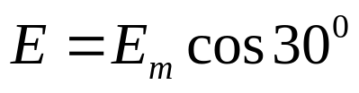
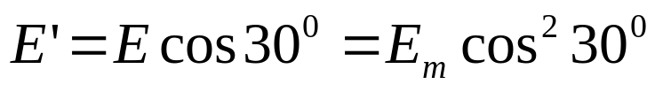
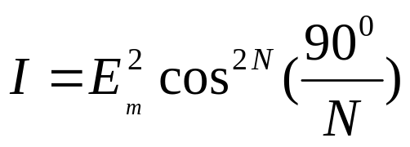
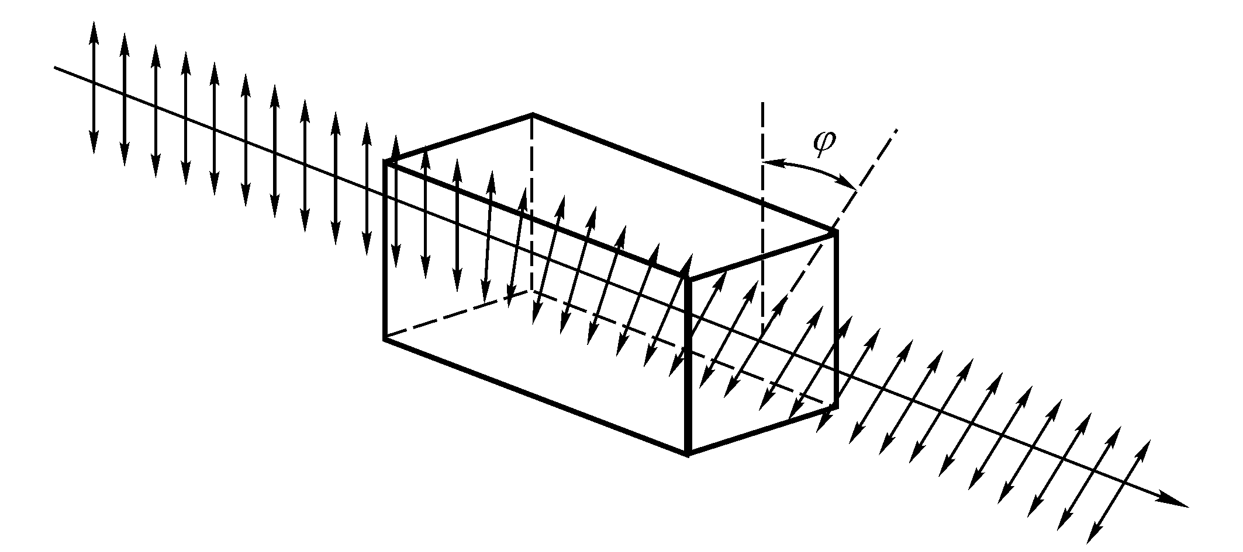
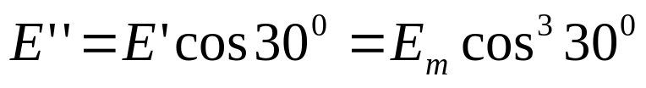
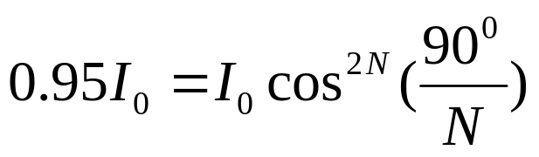
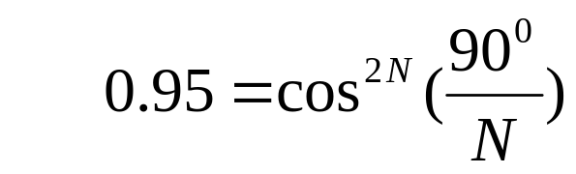
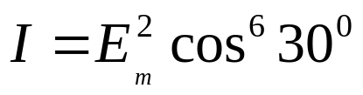
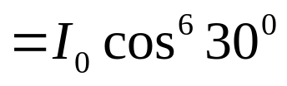




Example

Slide 18
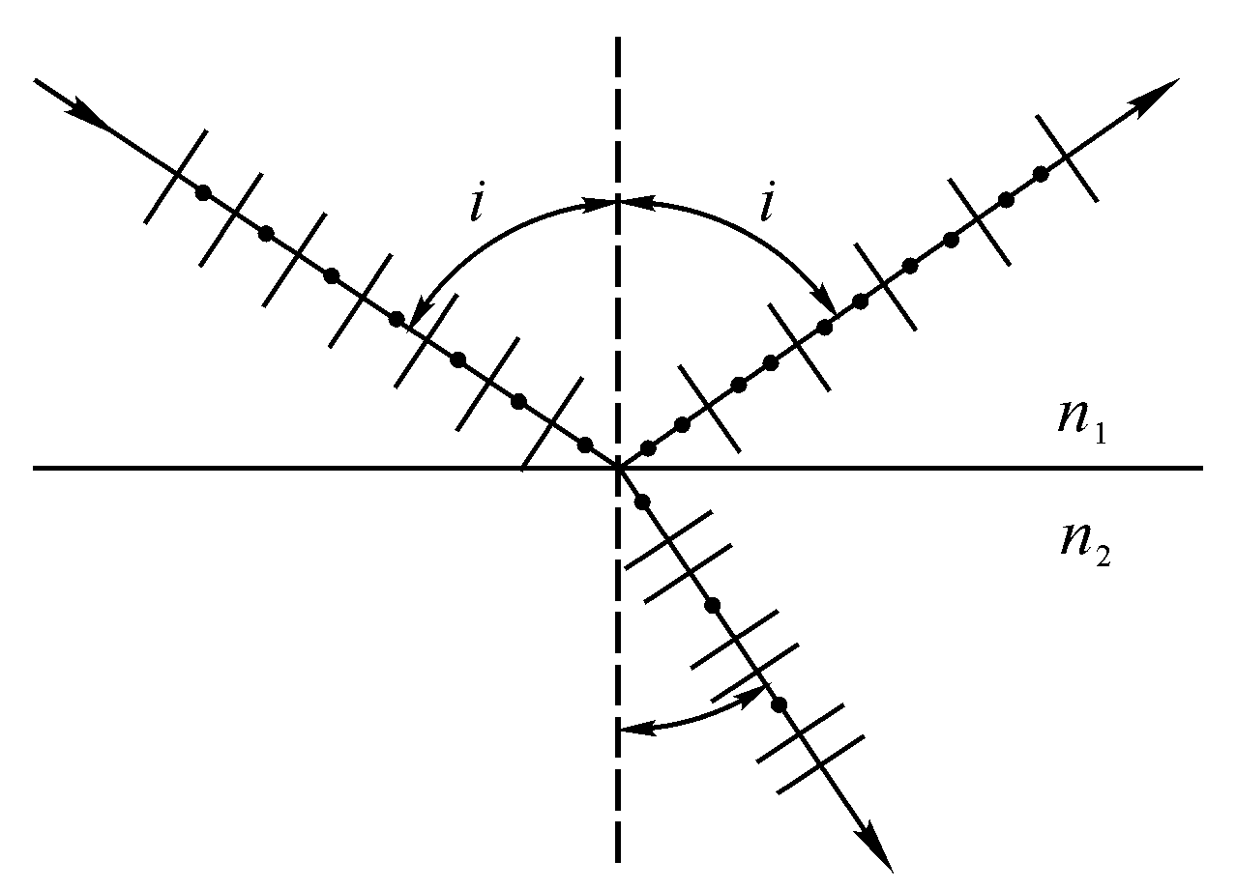
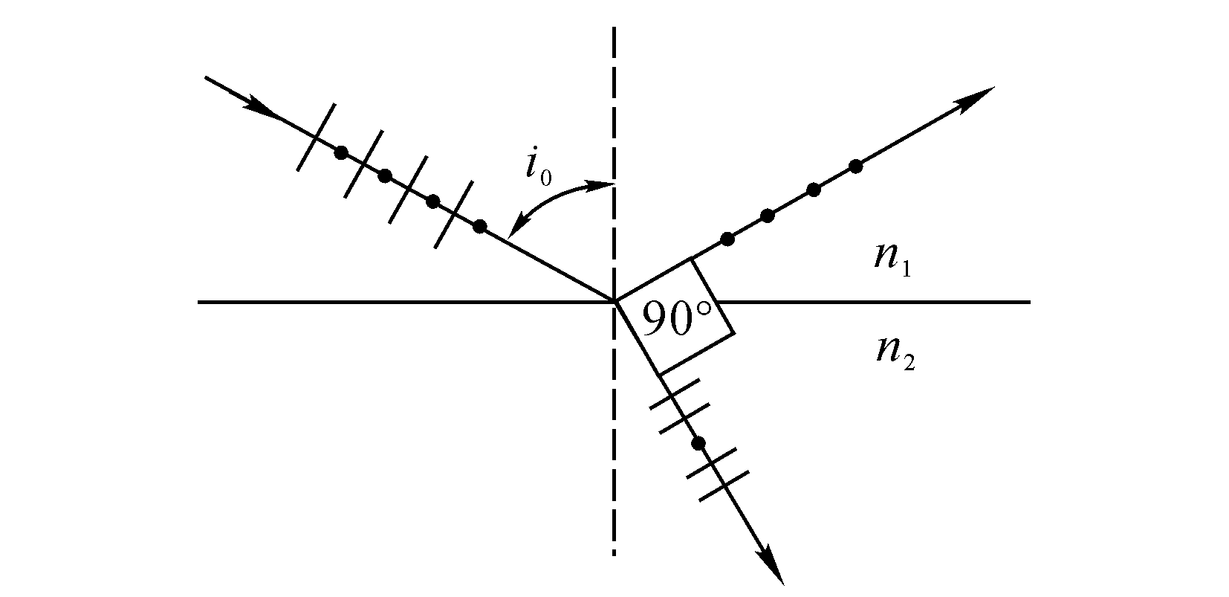
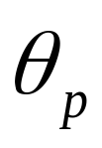
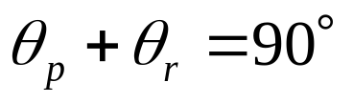

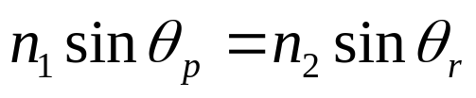
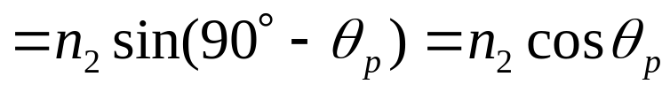
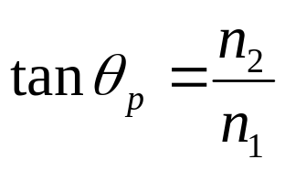
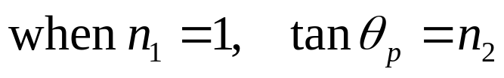
Polarization by reflection
The light can be partially or completely polarized by diflection.
When the incident angle is θ_{p}, the reflected light is completely linearly polarized (perpendicular to the plane). The refracted light is partially polarized.
Unpolarized light
polarized
θ_{p}
Partially polarized
θ_{r}
Partially polarized
partially polarized
Brewster’s law
Brewster’s angle

Slide 19
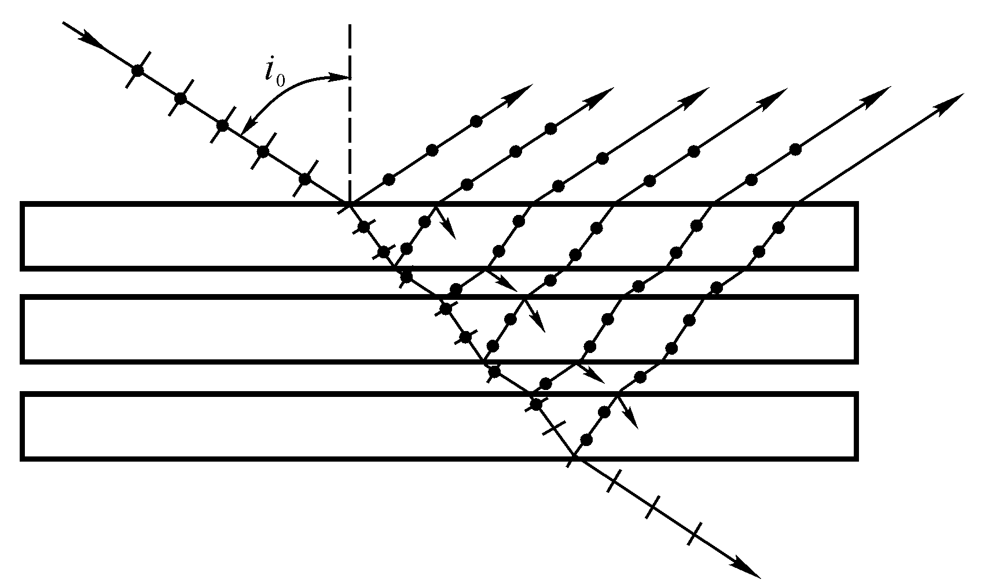
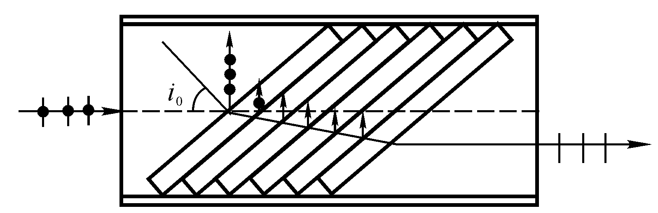
polarized
un-polarized
polarized
polarized
A stack of glass plates
polarizing sheet

Slide 20

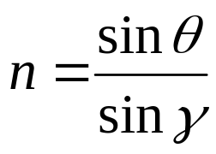

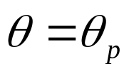


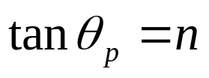
Example

Slide 21
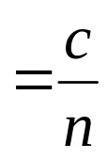
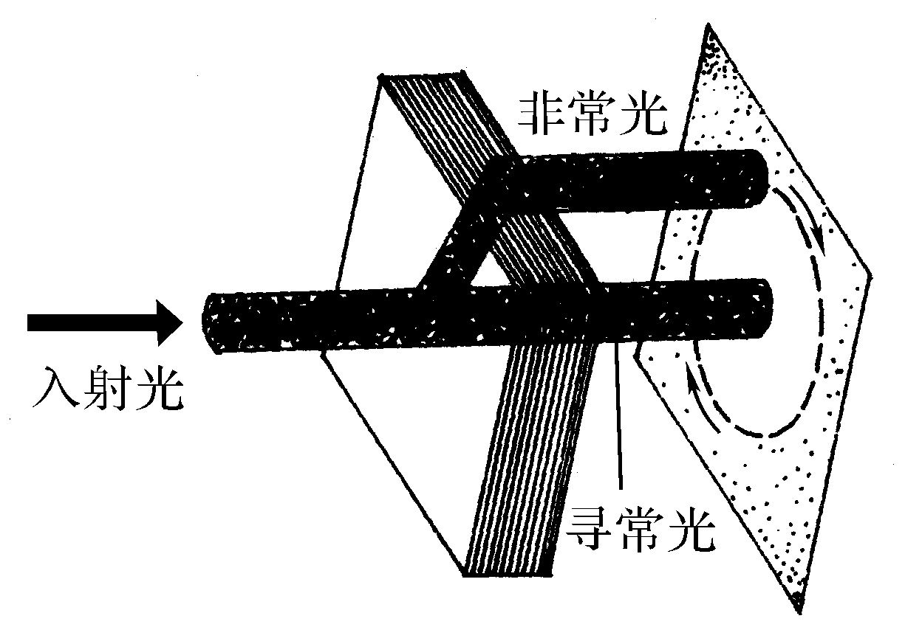
Double refraction
 The speed of light in matter
c
Optically isotropic: the index of refraction is independent of the direction of propagation in medium and of state of polarization of the light.
Optically isotropic: the speed of light is independent of the direction of propagation in medium and of state of polarization of the light.
double refraction (birefringence)
v
Optically anisotropic: the index of refraction and speed are dependent on the direction of propagation in medium and of state of polarization of the light.

Slide 22
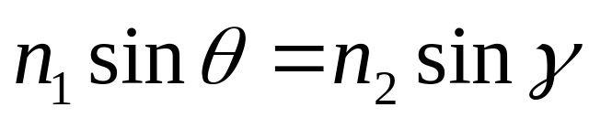
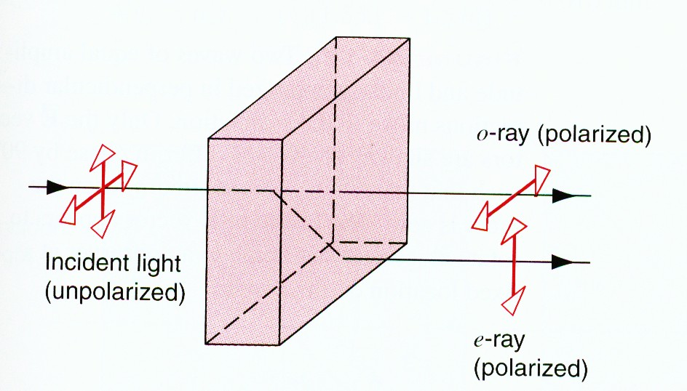
 o-ray and e-ray
Ordinary ray (o-ray): obey Snell’ law of refraction at the crystal surface.
Extraordinary ray (e-ray): does not obey Snell’ law of refraction at the crystal surface.

Slide 23
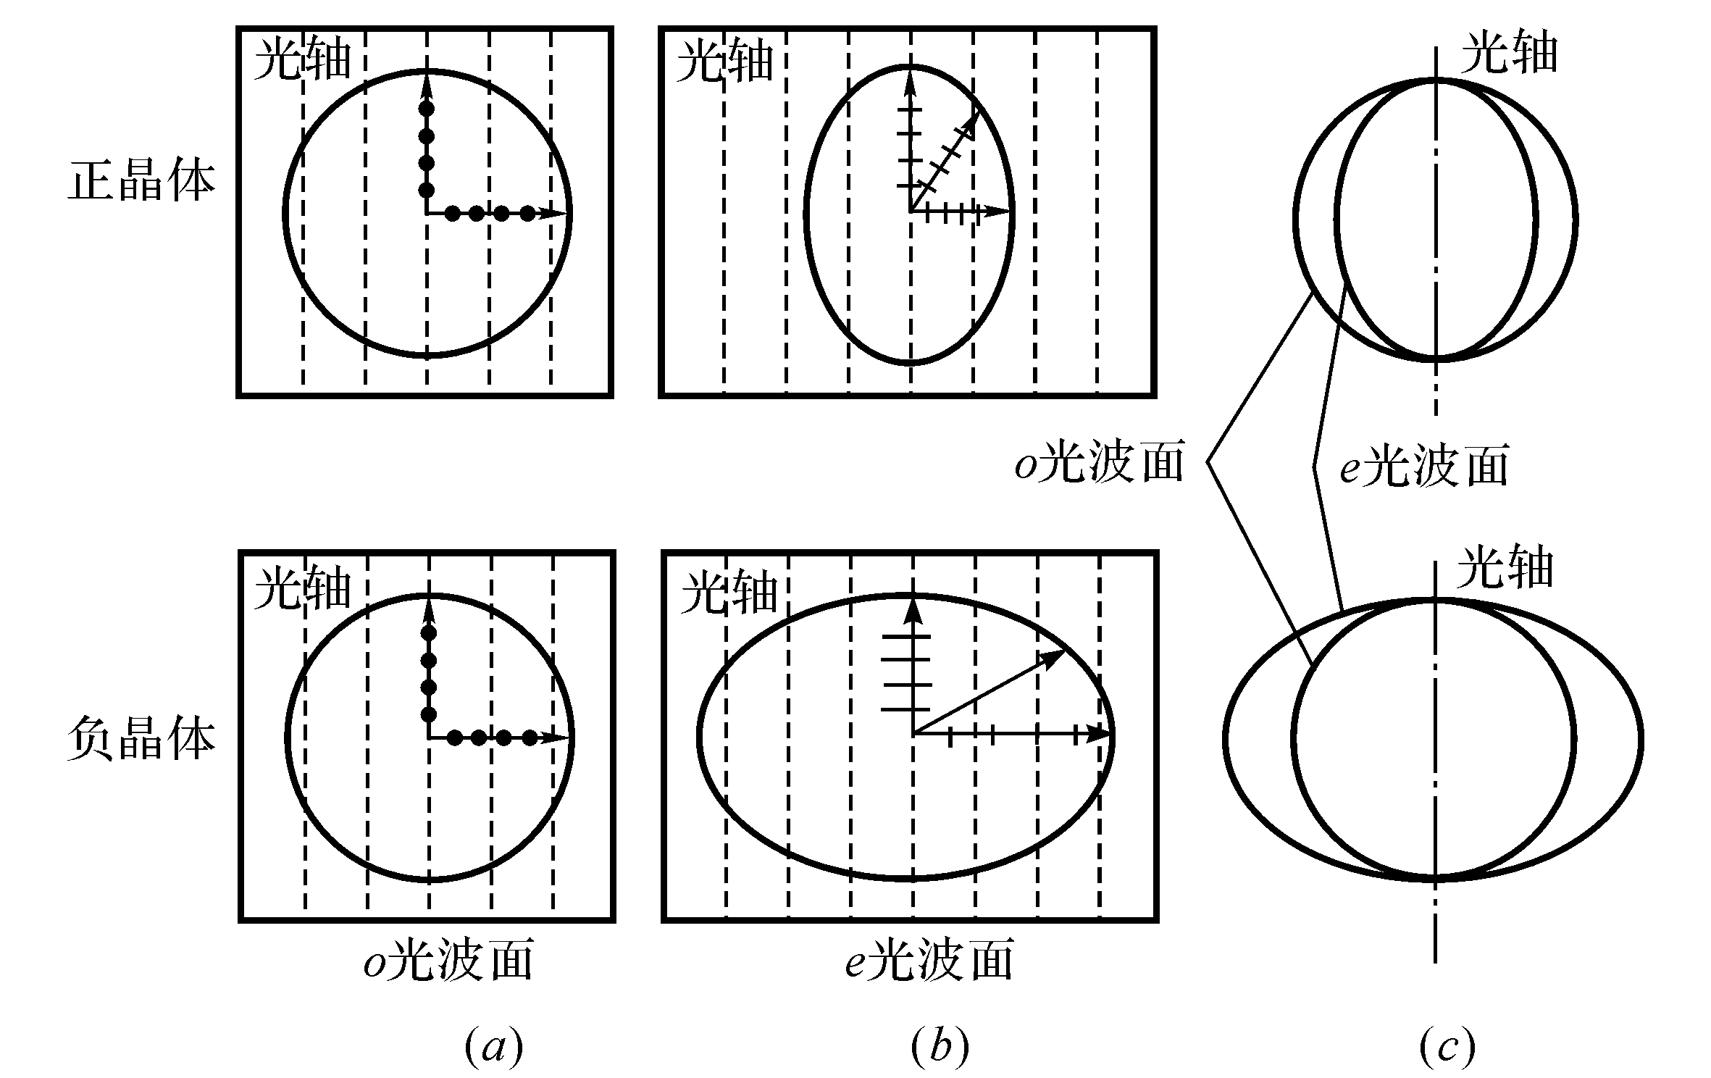
 The difference between o-ray and e-ray
o-ray: with the same speed v₀ in all directions, in other words a single index of refraction n₀.
e-ray: with the speed that varies with direction from v₀ to v_{e} the index of refraction varies with direction from n₀ to n_{e}.
Optic axis
Optic axis
o ray
e ray
o ray
e ray

Slide 24
 The difference between o-ray and e-ray
o-ray: with the same speed v₀ in all directions, in other words a single index of refraction n₀.
e-ray: with the speed that varies with direction from v₀ to v_{e} the index of refraction varies with direction from n₀ to n_{e}.
Optic axis
Optic axis
o ray
e ray
o ray
e ray

Slide 25
 The difference between o-ray and e-ray
o-ray: with the same speed v₀ in all directions, in other words a single index of refraction n₀.
e-ray: with the speed that varies with direction from v₀ to v_{e} the index of refraction varies with direction from n₀ to n_{e}.
Optic axis
Optic axis
o ray
e ray
o ray
e ray

Slide 26
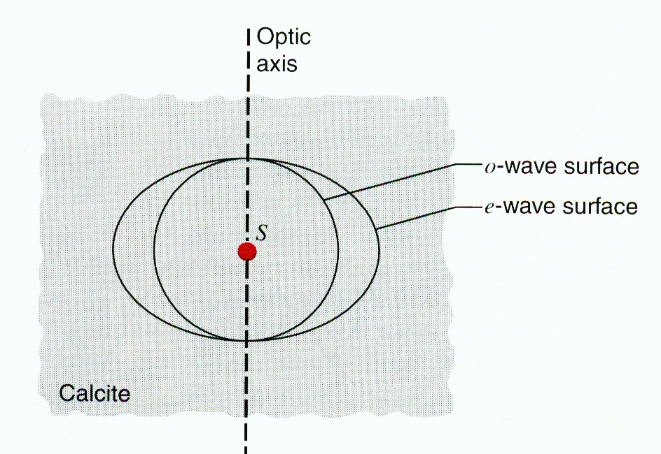

v₀>v_{e}
n₀<n_{e}
positive crystal
v₀<v_{e}
n₀>n_{e}
negative crystal
o-ray
e-ray
positive crystal
negative crystal
Optic axis
it is a direction in the crystal in which v₀=v_{e}
Principal indices of refraction n₀ = n_{e}.

Slide 27
Summary
polarized
Partially polarized
unpolarized
c
Polarizing sheets
I= I_{i} cos²θ
Law of Malus
v
θ_{p}
double refraction (birefringence)
θ_{r}
Brewster’s law

Slide 28
Homework:
P1012 5, 6, 8, 10, 13

Slide 29
Double refraction
Optically anisotropic: the index of refraction and speed are dependent on the direction of propagation in medium and of state of polarization of the light.
c
Ordinary ray (o-ray): obey Snell’ law of refraction at the crystal surface.
Double refraction
Extraordinary ray (e-ray): does not obey Snell’ law of refraction at the crystal surface.
v
v₀>v_{e}
n₀<n_{e}
v₀<v_{e}
n₀>n_{e}
positive crystal
negative crystal
o-ray
e-ray
Optic axis
In this direction v₀=v_{e} n₀ = n_{e}

Slide 30




Double refraction
Optic axis
Optic axis
Optic axis
Optic axis
Optic axis
Optic axis

Slide 31















Example
Which are o ray and e ray ?
What is d between two ray
d
Optic axis
o ray
e ray

Slide 32





Example
Linearly polarized light falls on a double refracting slab (n_{o}, n_{e}) with its optic axis parallel to the surface.
Two polarization states that were in phase before entering the slab are out of phase when they emerge from this slab. What is d
Half-wave plate
The slab is called half-wave plate if phase difference of o-wave and e-wave is π after they passing through the slab.
Optic axis

Slide 33


Linearly polarized light falls on a double refracting slab (n_{o}, n_{e}) with its optic axis parallel to the surface.
Different phase is π/2, when they emerge from this slab. What is d
Quarter-wave plate
The slab is called quarter-wave plate if phase difference of o-wave and e-wave is π/2 after they passing through the slab.
Optic axis

Slide 34











Circular polarization
Quarter-wave plate
Right-circular

Slide 35



Circular polarization
Quarter-wave plate
Left-circular

Slide 36


Circular polarization
Quarter-wave plate
α
Ellipsoid
Right-circular

Slide 37





Circularly polarized wave
unpolarized
polarized
Circularly polarized wave
polarizing sheet
Quarter-wave plate
Left-circular
Right-circular

Slide 38




Half-wave plate
Linear polarized

Slide 39
unpolarized and circular polarized light
Quarter-wave plate
unpolarized
unpolarized
circular polarized
linear polarized

Slide 40

Polarization by scattering
Light scattered sideways from a gas can be partially polarized.

Slide 41


Application:
Incident
Liquid crystal
Polarized direction
emerging

Slide 42
summary
Optic axis
In this direction v₀=v_{e} n₀ = n_{e}
v₀>v_{e}
n₀<n_{e}
v₀<v_{e}
n₀>n_{e}
positive crystal
negative crystal
o-ray
e-ray
polarized
Optic axis
Circularly polarized wave
unpolarized
polarizing sheet
Quarter-wave plate

Slide 43


A quartz (n_{o}=1.544, n_{e}=1.553) quarter-wave plate to be used with sodium light (λ=589nm), what is the minimum thickness of the plate?
Example

Slide 44
A quartz (n_{o}=1.544, n_{e}=1.553) quarter-wave plate to be used with sodium light (λ=589nm), what is the minimum thickness of the plate?
Example
When a linear polarized light falls on the plate, what is the rotation direction of the circularly polarized light?
Right-circular

Slide 45
Exercises
P1012-1013 7, 12, 14, 15, 16,

